Slide 1
Women’s “Her”story Month Picket Sign/Poster Collage
Heather Kim
Marlena McClain
Tina Keshishian

Slide 2
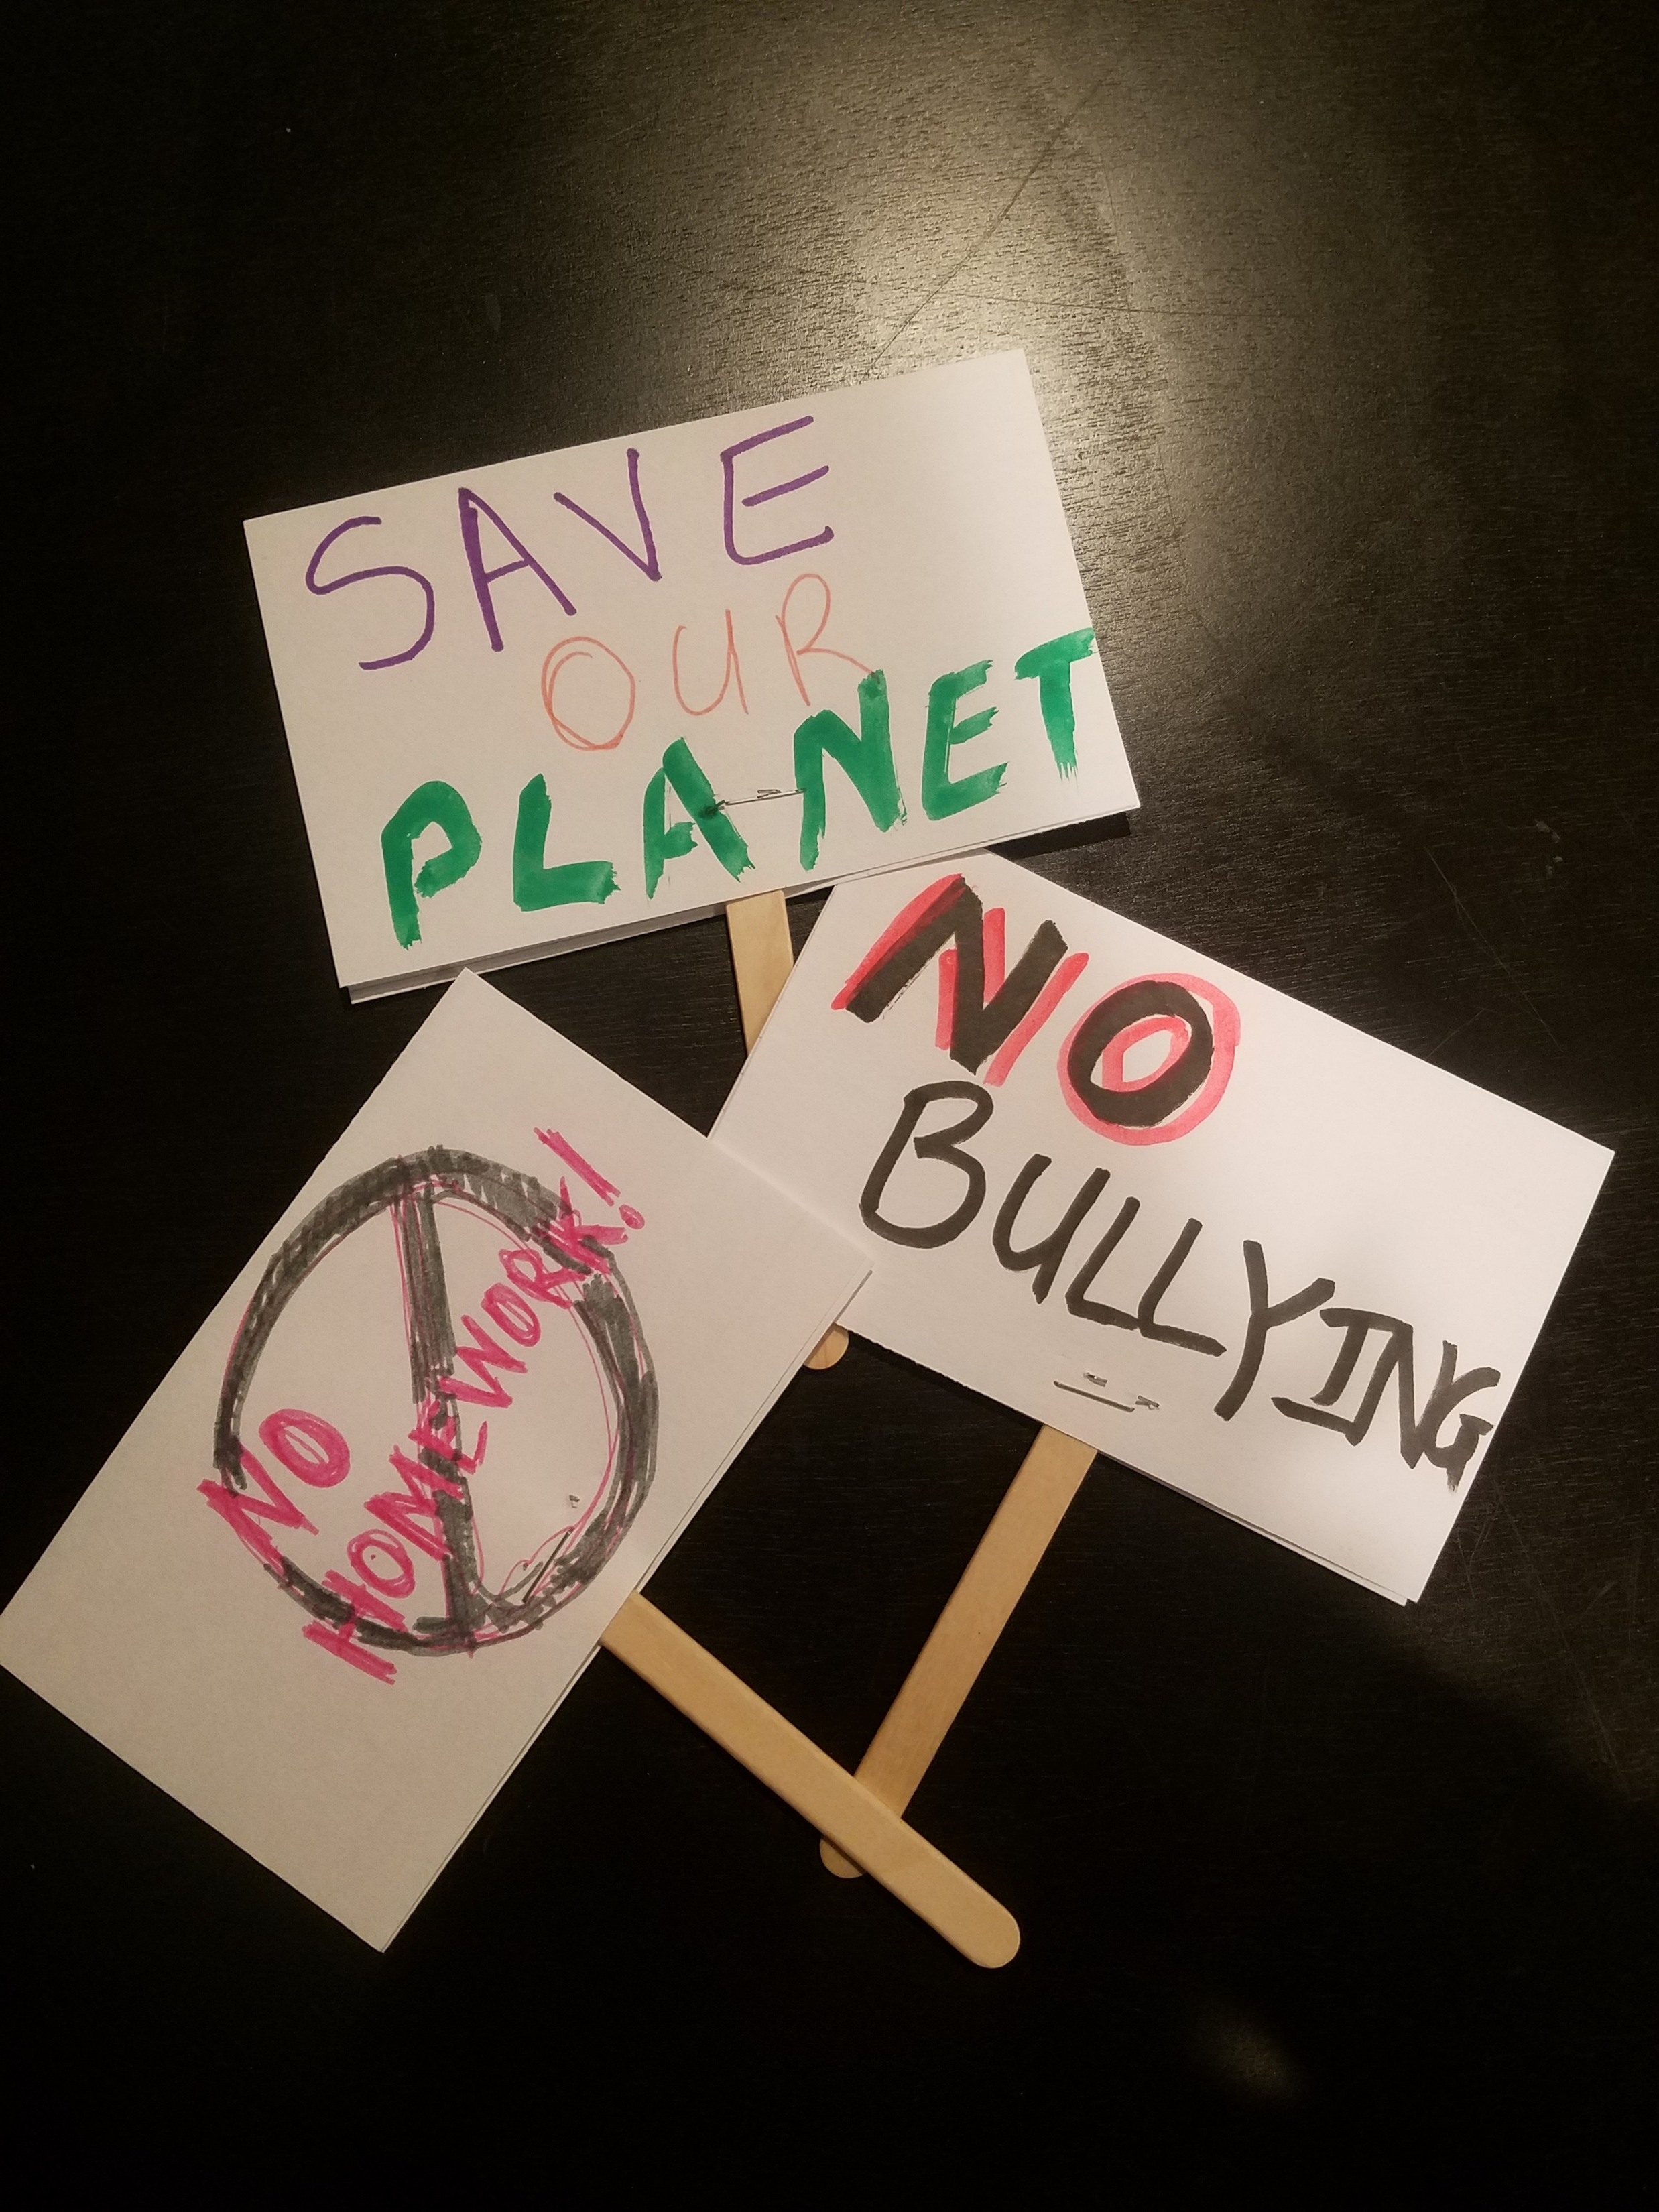
Anticipatory Activity
Create a protest board
To create new ideas
Talk to each other about their ideas
Develop an idea which can be transformed in to digital media and create art digitally

Slide 3
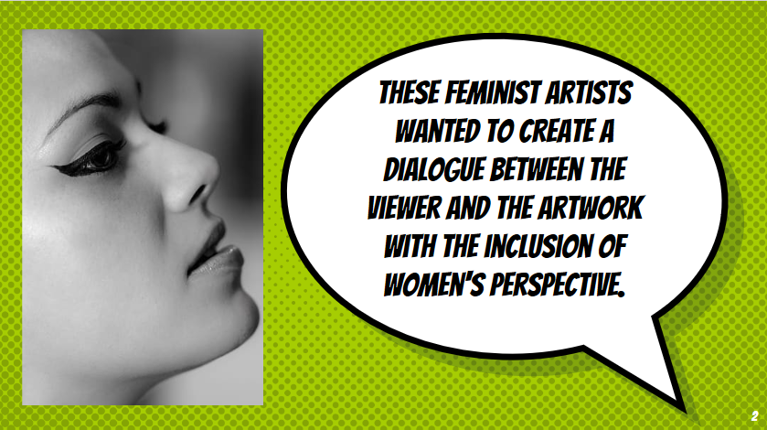
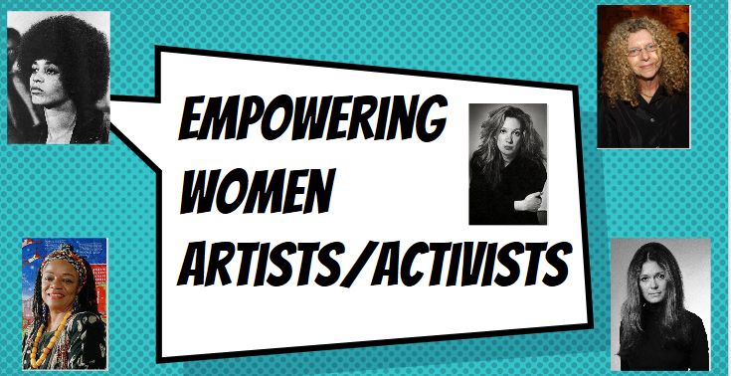
Art History Presentation
History of empowering woman
Role of Woman in Important historic events
How woman are changing the perception of the world
Art relation to the woman empowerment movements

Slide 4
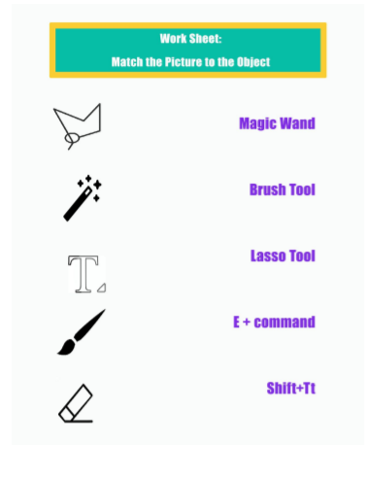
Worksheet
Get students familiar with the photoshop tools
Asses how much the students already know

Slide 5
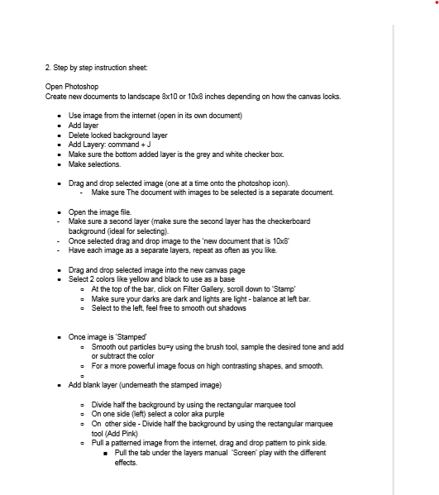
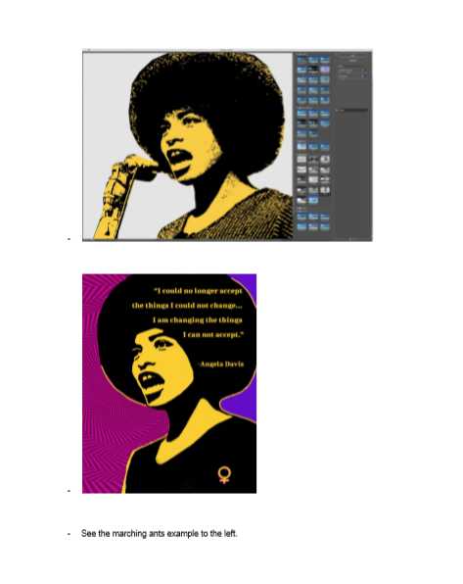
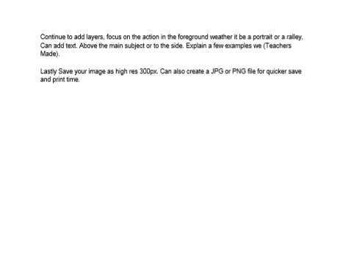
Instruction Sheet
Photoshop
Making layers
Cutting images that are part of another image
Adding text
Learning tool shortcuts with keyboard

Slide 6
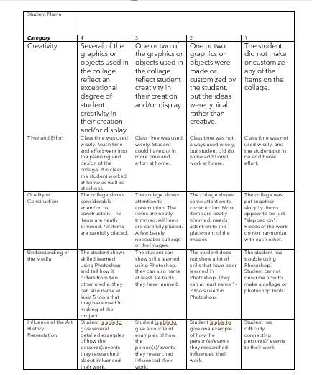
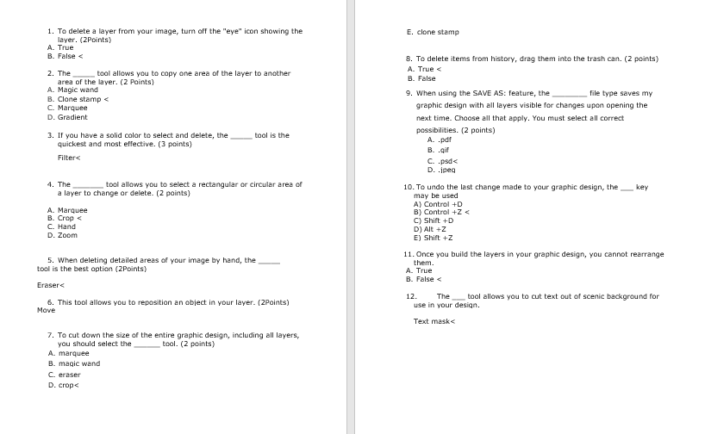
Grade Sheet and Quiz
Grade Sheet
Creativity
Art Criticism
Quality of Construction
Art Connection to History
Effort
Art Production
Quiz
Photoshop skills that have been learned
Simple history test about what they have researched about

Slide 7
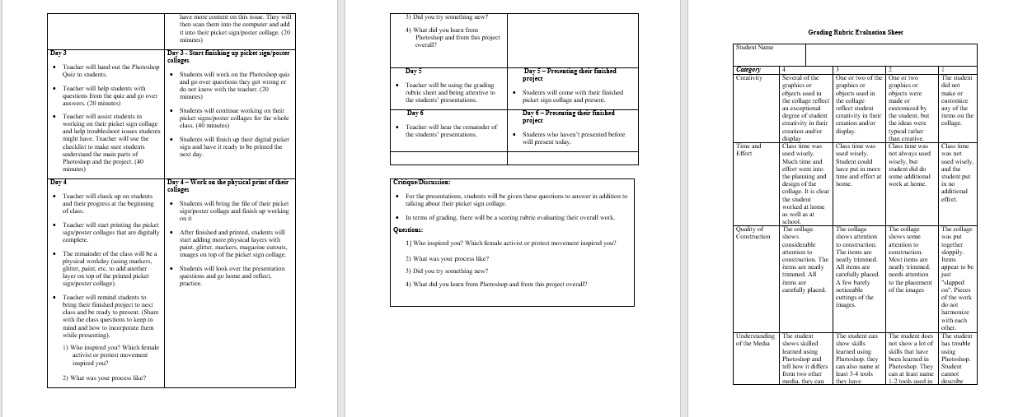
Lesson Plan

